Slide 1
JEMS for NEXT MED
Overview of JEMS

Slide 2
What’s JEMS
Jems* is the Joint electronic monitoring system developed by Interact.
It supports the full programme and project lifecycle, from application to payments.
The success of Jems can be seen through its key achievements:
More than 50% of Interreg programmes use Jems
80% of beneficiaries find Jems easy to use
* INTERACT definition

Slide 3

JEMS – Registration and functionalities

Slide 4
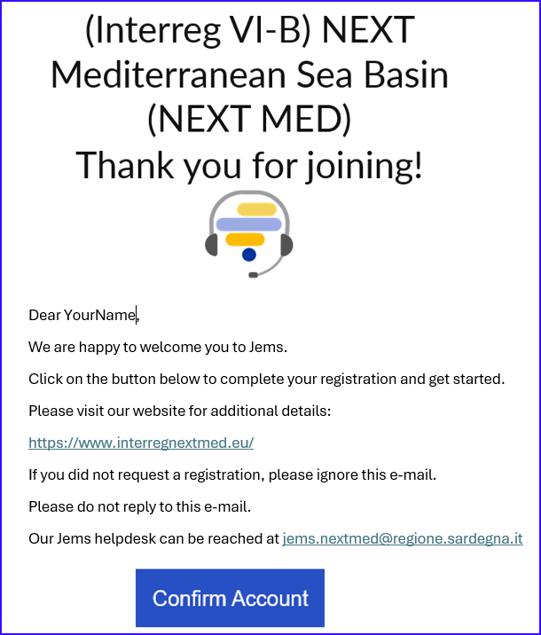
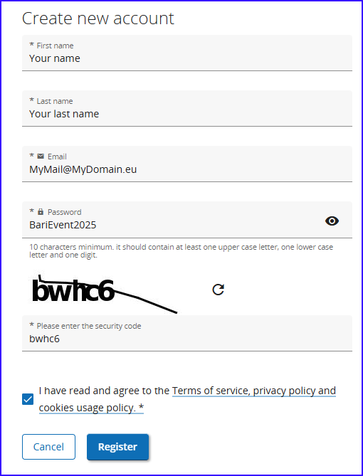
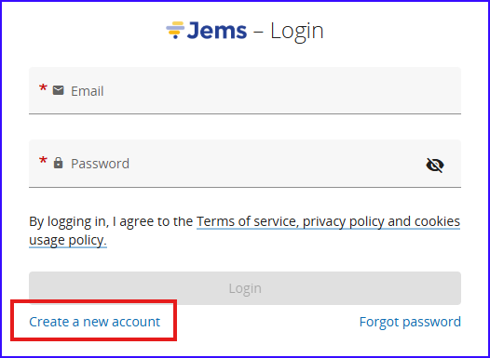
JEMS – First steps
On https://jems.interregnextmed.eu/ , click “Create a new account”
Fill the basic information and click “Register”
Confirm the registration by clicking the button on the mail received
You’re in!
As easy as 1,2,3!

Slide 5
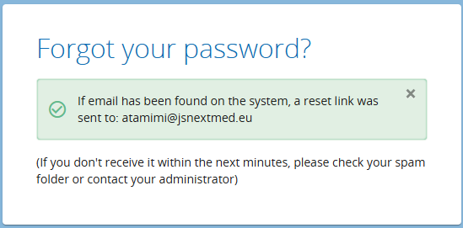
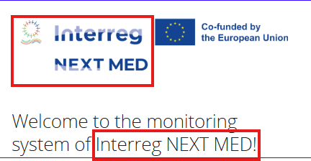
JEMS – First steps
If you forget or loose your password, you may recover it from the login page by clicking “Forgot Password”, you will receive a link to reset it.
Don’t forget to check your spam folder if you don’t receive it!
Take the advance and add to your safe list of mail jems.nextmed@regione.sardegna.it
It’s used for:
  Activating the account
  Reset password
  Support
Points of attention: links send via JEMS expires after 7 days!
Make sure to react within this period when you register or reset your password
Make sure you are in the right programme JEMS!

Slide 6
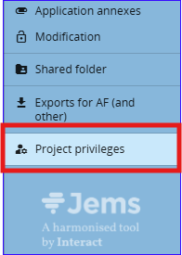
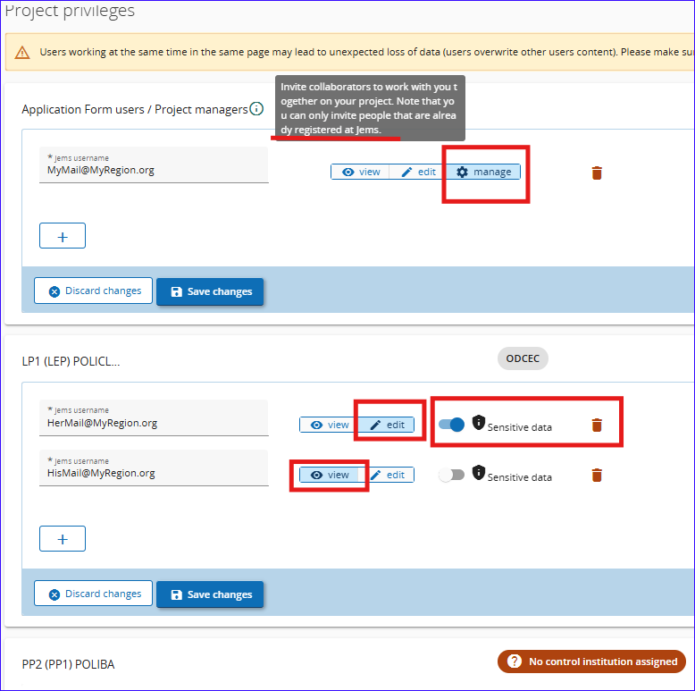
JEMS – Privileges
The Lead Partner of the project can give the privileges to the project and its management in JEMS.
The access can be given only to users already registered in JEMS.
The possible rights are:
Manage: can access all sections and use all functions, including the “privileges” (that’s why it should be limited to the minimum number of users!).
Edit: to be defined for one user at least for each partner
View: To see the sections without the possibility to insert or modify anything.
Sensitive data: You may prevent a user from seeing in Budget Lines their description, comments or related document.

Slide 7
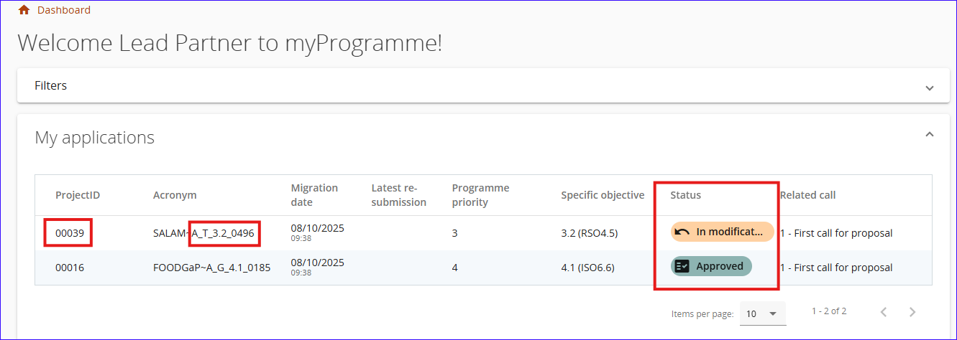
JEMS – Overview - Dashboard
LP: Contact the JS for the assignment to the project (if you are the LP/PP in several projects, you can inform us to assign them to one user)
PP: Contact your LP for the assignment to the project (if you are the LP/PP in several projects, you can use one user to access all your projects)
On the landing page after login, you find your applications (projects) to access them.
You have general information about the project, including its status, objective, the acronym with the reference number, and a project ID assigned automatically by JEMS

Slide 8
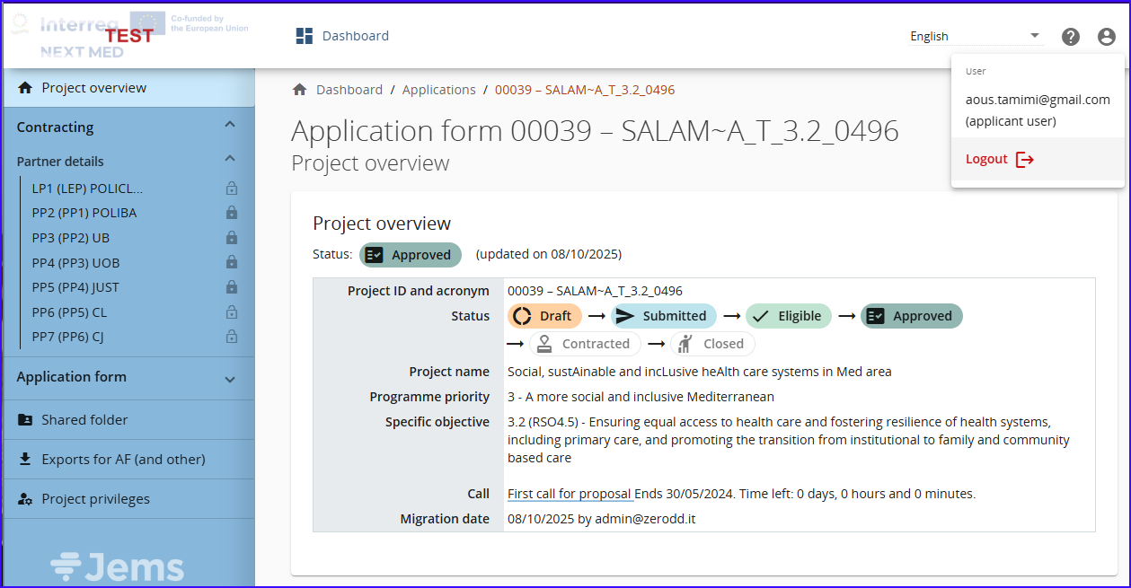
JEMS – Overview - Main Project Page
When entering a project, you’ll have the project overview, with the status current step, priority, specific objective… etc.
On the top right, you can:
Switch languages (English and French),
Access the “User Menu” where you can modify your password and,
Activate or deactivate notifications from JEMS by mail.

Slide 9
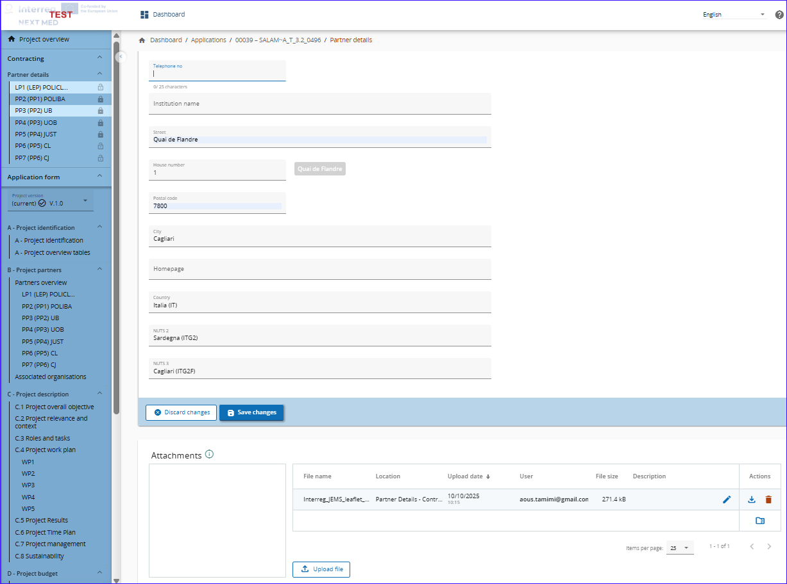
JEMS – Overview
Main Project Page
Left-side blue menu
Partners details:
Here you can set
Your bank details
Location of documents (for audit and control)
Upload related partner’s document

Slide 10
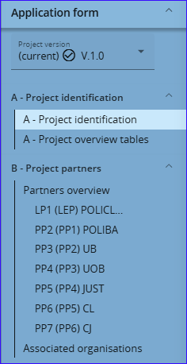
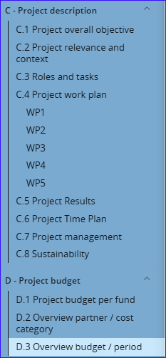
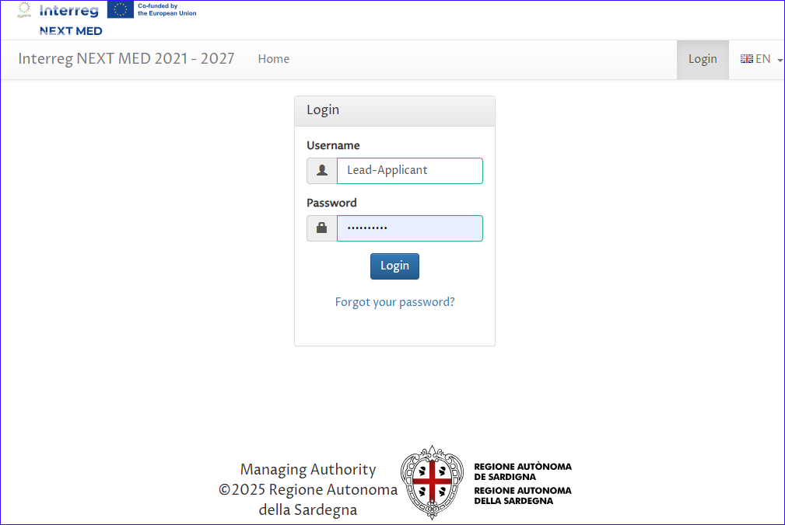
JEMS – Application Form - Sections
In the “Application Form”, the latest approved application is set by default
All sections and sub sections of the original approved application are transferred from the eForm to JEMS

Slide 11
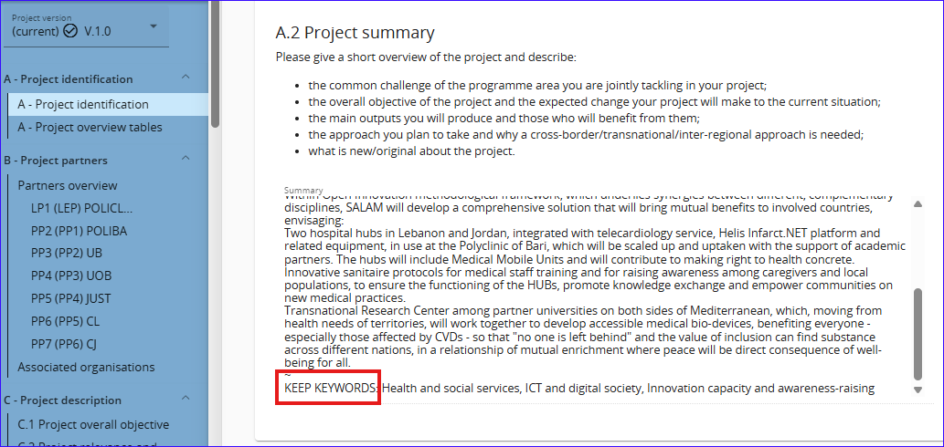
JEMS – Application Form – Characters limit
Due to standards agreed with all programmes using JEMS, the fields distribution and the specificity of NEXT MED programme, some fields are merged.
In another limitation to the characters number, some text fields are truncated (cut); these fields are marked with dots (…) at its end.
These limits are close to the eForm and you’ll have the possibility to adjust to it.

Slide 12
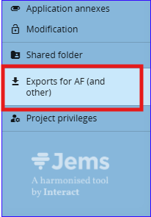
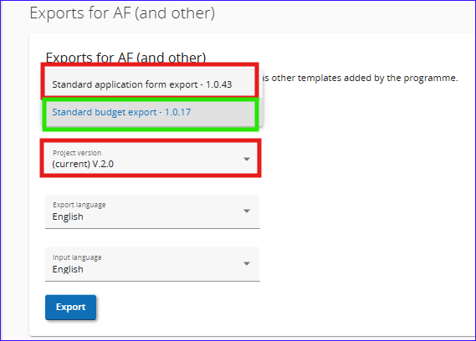
JEMS – Export
In the Exports for AF (and others), you can choose to export:
the Application Form (in PDF version), or,
the Budget (in Excel format table)
If you have more than one version of the AF, then you can choose to download any of the versions (after the negotiation or adjustment of project, for example)

Slide 13
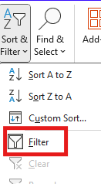
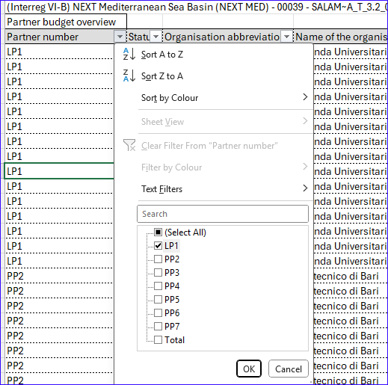
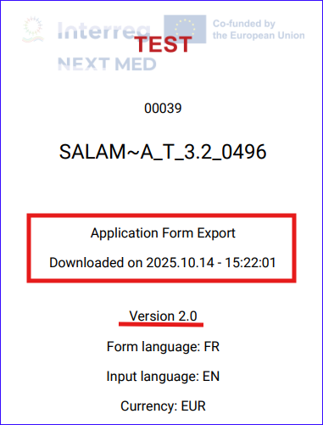
JEMS – Export
The exported PDF of the application is stamped with date, time and the version of the downloaded file.
The exported budget table contains 2 tabs, one with project totals and the other with detailed budget per partner.
You may filter it using Excel function

Slide 14
JEMS – Modifications
For Negotiations and Amendments

Slide 15
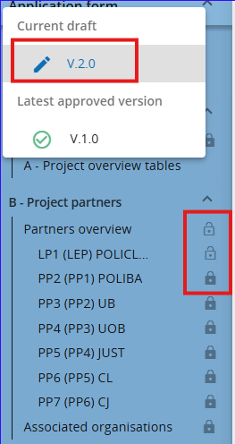
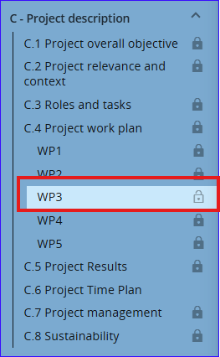
JEMS – Application Form – Modification
You might need to modify the application, during:
The negotiation procedure
Minor or major amendment to the project
The JS/MA would allow you to modify the application, and the new draft version is created with the sections agreed on modifying are unlocked.
The unlocked sections can be seen with the clear icon next to them.

Slide 16
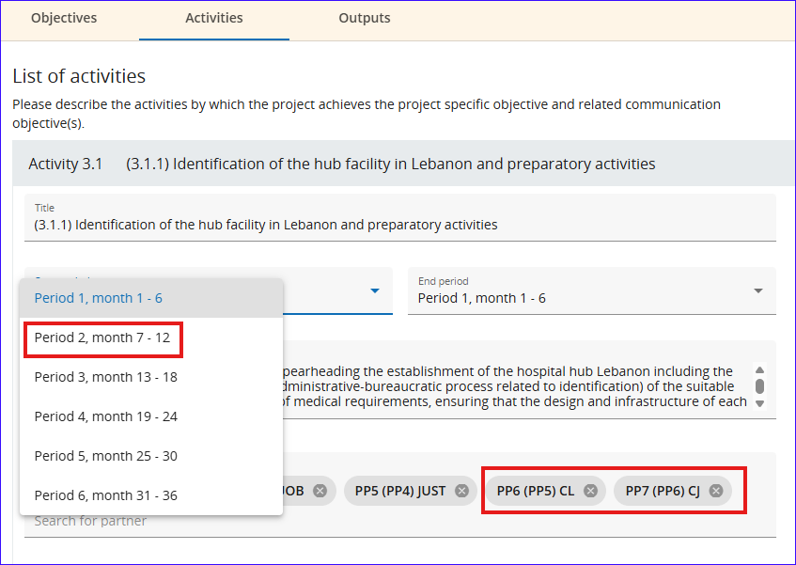
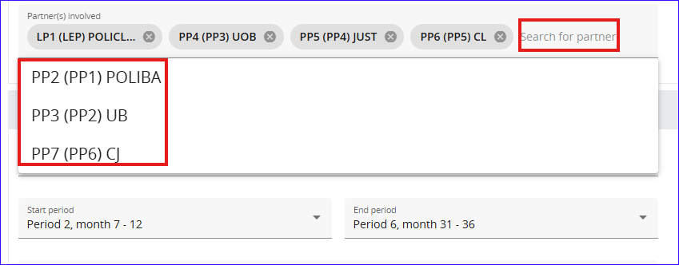
JEMS – Application Form – Modification
When a section is unlocked, all its subsection will be modifiable wherever allowed.
You’ll be able to correct the text, adjust it to the limit in JEMS, involve partner or remove their involvement in activities… etc.

Slide 17
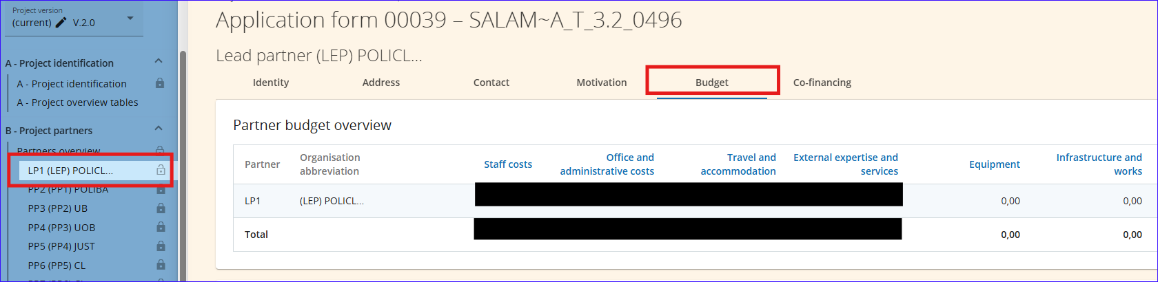
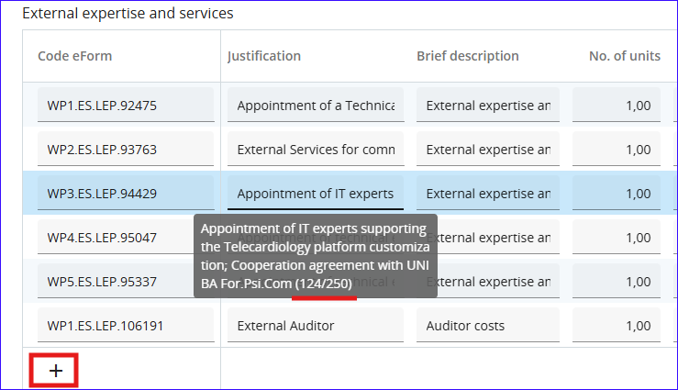
JEMS – Application Form – Budget modification
In the Application Form “editable version”, the “Budget” sub-section is where to modify or adjust the budget.
You can modify or add/delete a Budget Line (BL).
Attention:
  “Justification” field (limit 250 characters),
  “Brief description field (limit to 100 characters)
  Resulted budget must equal or less than the total approved budget of the project

Slide 18
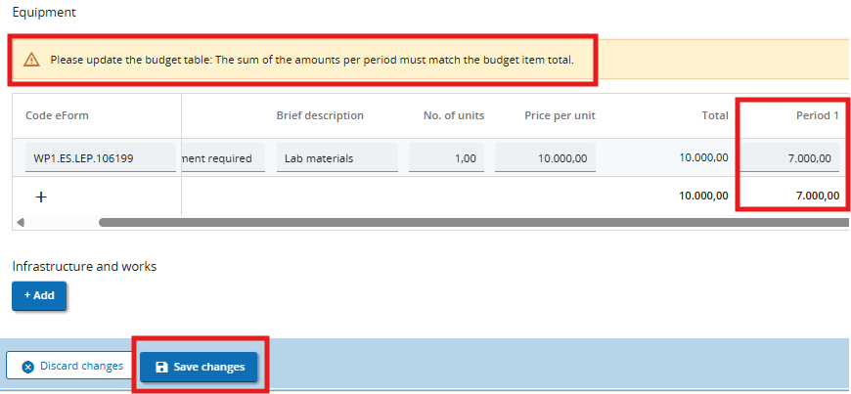
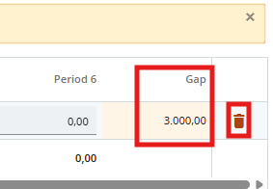
JEMS – Application Form – Budget modification
When modifying the amount of a BL, or adding a new one, you get a notification if the budget distribution on semesters are not correct, with the indication of the difference in amount, in the “Gap” column.
Attention:
When adding a new budget line, respect the coding of the lines by using, as example:
WPx.HR.PPP.999901, 02…
WPx = WP Number
HR/ES.. cost category
PPP= Partner number or LEP
9999 or 1111 ➔ as a start of the unique code then followed in order 01, 02… etc

Slide 19
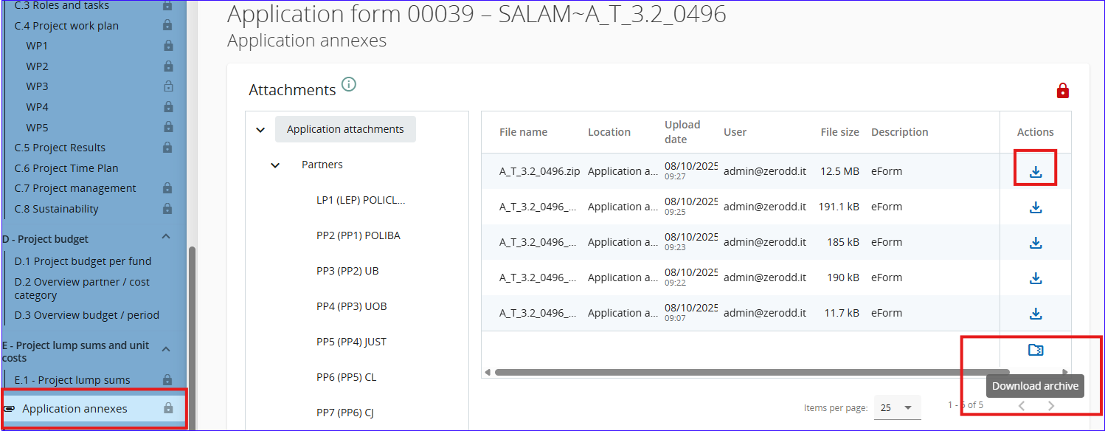
JEMS – Application Form – Application Annexes
If the text of a section is truncated or if you need to see the original submitted Application, no need to go back to eForms, you can find it in “Application annexes”.
You can download each file separately or all files in the section using “Download Archive” button.

Slide 20
JEMS –Application Modification – Points of attention
The modification can be opened by the JS/MA
Modifications are to be done by the LP, apart from the information related to the partner information.
The different versions of the AF can be accessed from the left menu.
The unlocked sections are marked with light lock, if you need to edit other sections, you have to ask the JS to open them for you.
To change the regions of the address, you must start chronologically: Country, NUTS2 & then NUTS3
If the modified page can’t be saved, then check first the characters limit in that section.
The priority and programme specific objective of a contracted project cannot be changed.
Flat rate options cannot be changed.
Existing activities, deliverables, outputs or results cannot be removed but can be deactivated.

Slide 21
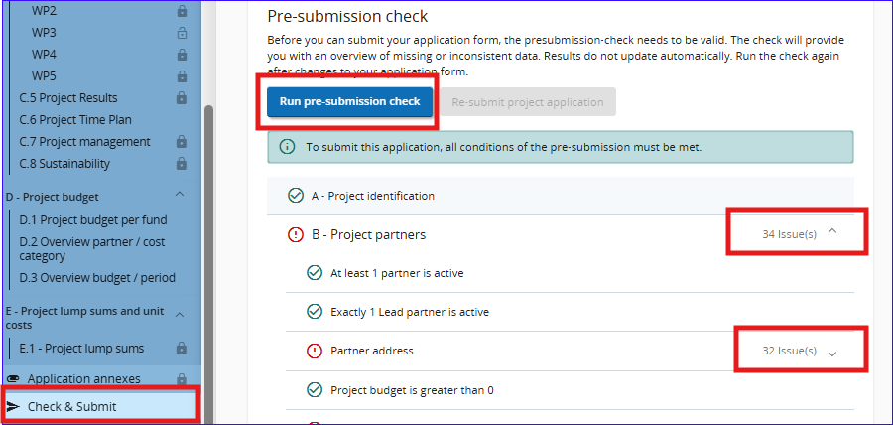


JEMS – Application Form Modification
Pre-Submission check
Prior to the resubmission of the modified version, you should run the pre-submission check and correct all issues, if any.
This is a basic check and doesn’t guarantee the approval of the modified AF.
When the submitted version is approved by JS/MA, you’ll see it by default as its the latest version.

Slide 22
JEMS – Reporting

Slide 23
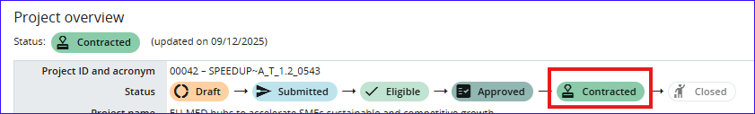
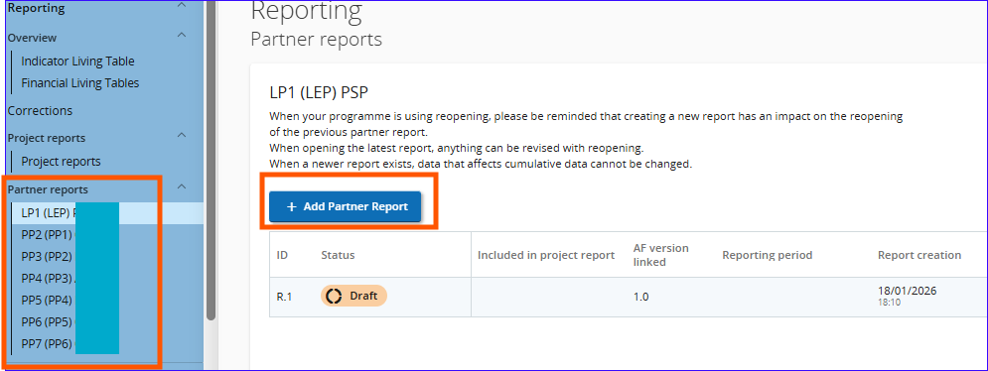
JEMS – Reporting – Creating a report
When the project is in contracted status, the reporting section is opened for reports creation.
You can now Add Project Report and start filling
Each partner is responsible for filling its part

Slide 24
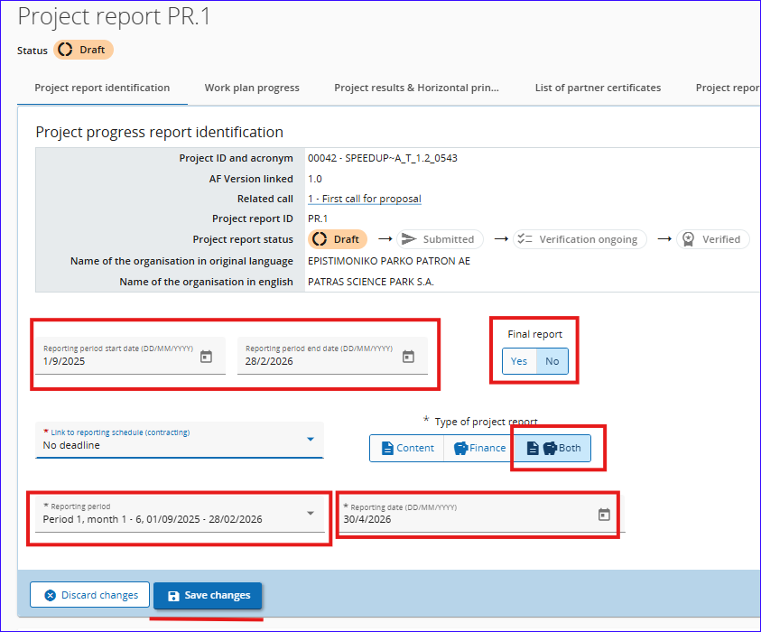
JEMS – Reporting – report Identification
The reporting period drop-down menu is pre-defined, according to the contract signatures; Select the suitable reporting period.
Unless it’s the Final Report, select always “No” for the Final report field.
As for the Start and End dates of the reporting period, fill-in the same dates as per the reporting period, unless instructed otherwise by the JS/MA.
The Type of the report for NEXT MED is always “Both”

Slide 25
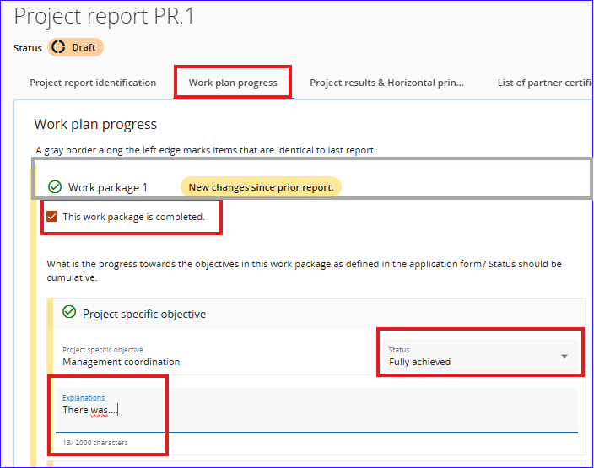
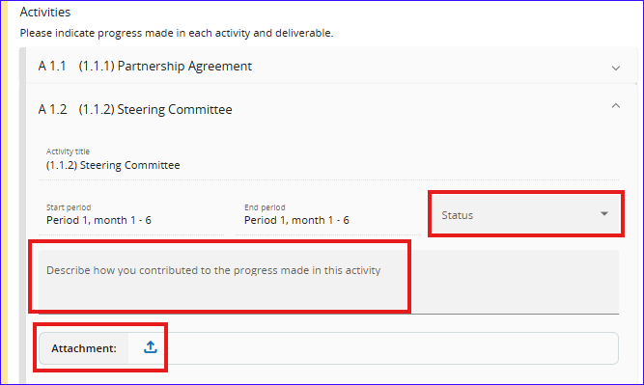
JEMS – Reporting – Work Plan Progress
Click on the area highlighted in grey to expand the section,
Introduce the description of the progress, status of the work package and tick the box if you completed the WP.
Same for the related activity and Output.
The documents related to the activity is to be uploaded here (Output attachments are just under Output).

Slide 26
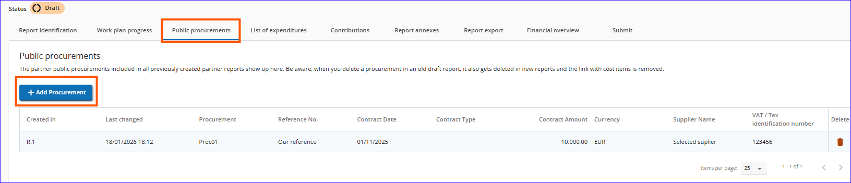
JEMS – Reporting – Procurement
In this section, information related to the procurement, following the guidelines, are to be filled.
Please refer to the PIM for further information

Slide 27
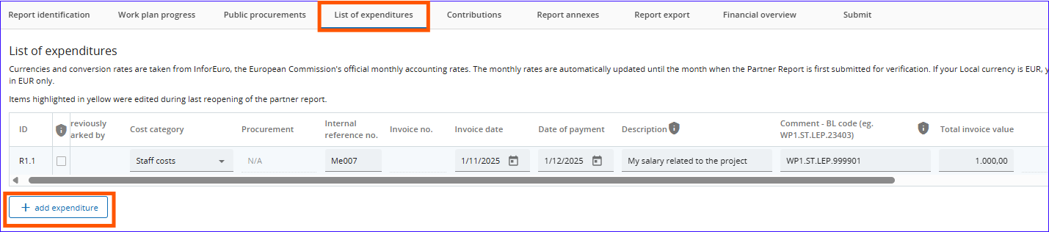
JEMS – Reporting – List of expenditures
The expenditures incurred and paid in the reporting period are to be filled in here,
You can “add expenditure” and fill all the related fields.
The ones highlighted with shield are the “sensitive data” to be hidden from unauthorised persons.

Slide 28
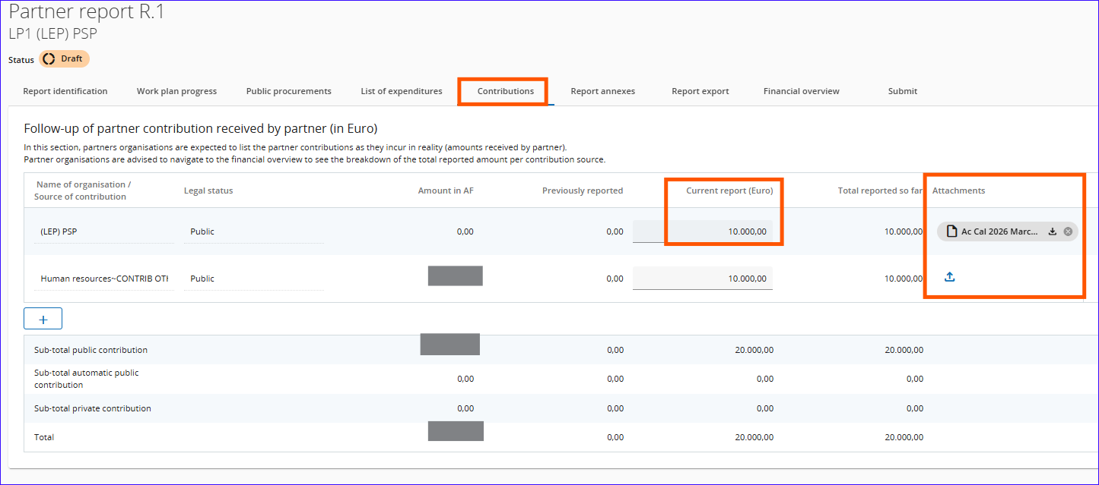
JEMS – Reporting – Contribution
Fill in this section the partner contribution and upload the related documents.
If it’s the second report or later, the cumulative amount will be seen.

Slide 29
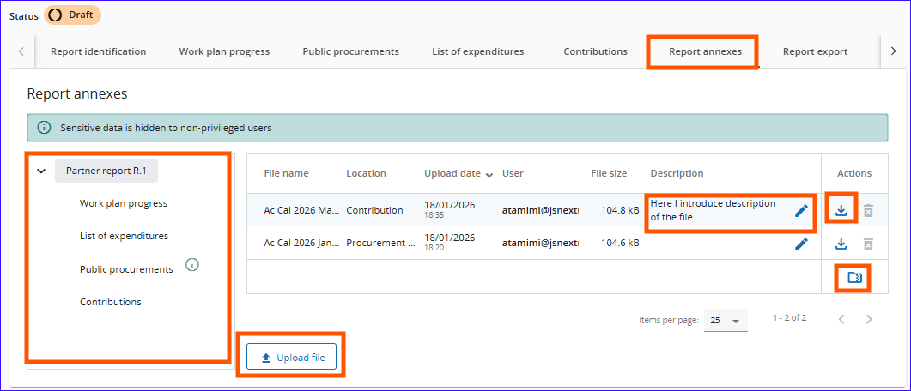
JEMS – Reporting – Project Report Annexes
This section shows all uploaded files in other sections with directory tree.
You can download a file, all files (in zipped folder) or upload new files.
Points of attention:
Do not upload documents you are not required, nor requested, to upload.
Compress files related to the same catgeory as one zipped file
Name files in comrpehensive way
If you scan documents, make sure that they are readable and with reasonable size.

Slide 30
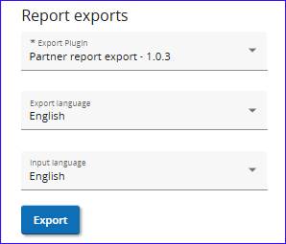
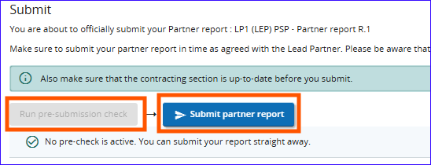
JEMS – Reporting – Export and submission
You can export the report in PDF format by selecting the right plugin.
The exported file is stamped with date and time,
You may export the file in English or French.
Prior to the submission, you have to click on “Run pre-submission check”,
Then “Submit”

Slide 31
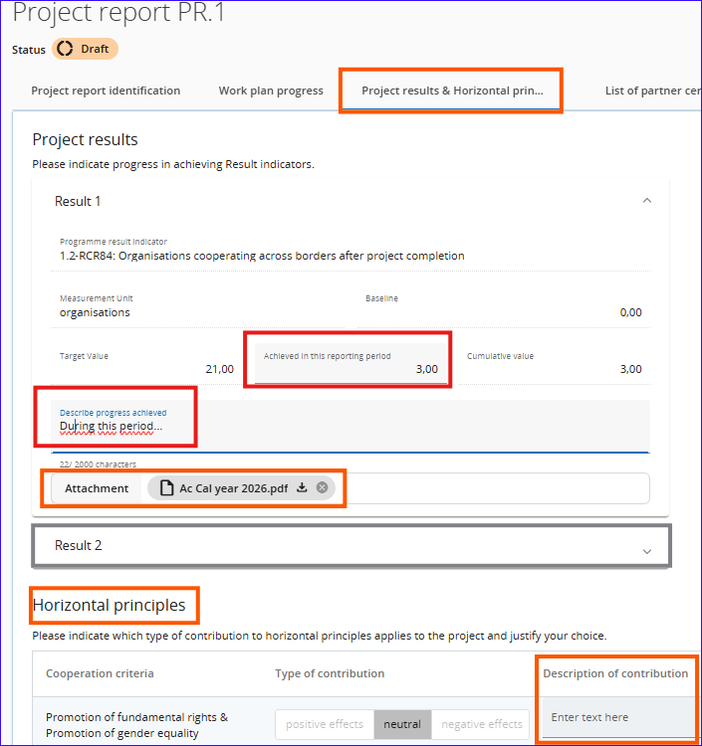
JEMS – Reporting – Project Results and horizontal Principles (LP)
Introduce the value of the achieved result for this reporting period and describe.
The description of the Horizontal Principles are to be filled in this section too.
The documents related to the filled result is to be uploaded here

Slide 32
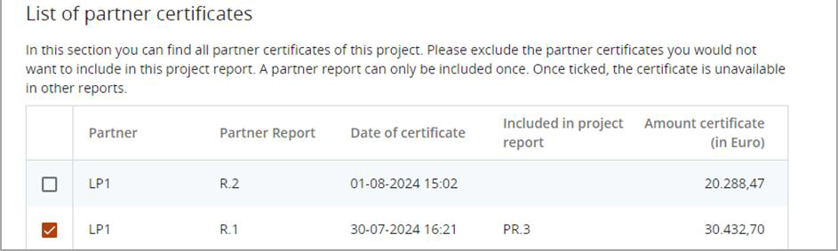
JEMS – Reporting – List of Partner Certificates
Upon creation of a new project report, all available partner certificates, which are not yet included in any other project report, are included in the newly created project report.
If a certificate shall be excluded in this project report, the respective partner certificate needs to be unticked
Point of attention: You can include here Certificates from an earlier or the current reporting period only (No certificate from the next reporting period to be included)

Slide 33
JEMS – Documents
Where should I upload the required documents

Slide 34
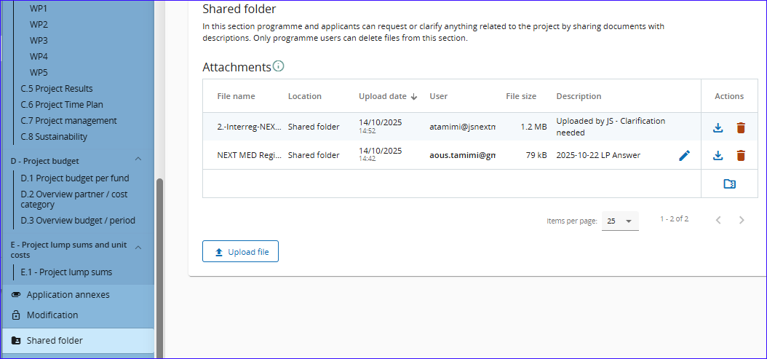
JEMS – Shared Folder
Shared Folder can be used to exchange documents with the JS and MA.
Keep file names clear and expressive, you can add short description to clarify further if needed.
As for annexes, you can download the files individually or a bulk in a compressed file.
The details are in Annex A of JEMS Guide

Slide 35

JEMS – Next Steps
Register to JEMS (see slide 3)
Wait for the assignment of the project to be received by JS (if you are the LP of several projects, inform us to assign them to one user)
Give the privileges to your project users (for the Lead Partner and Partners)
If needed, apply the modification to the Application Form, as agreed with the JS
Start with the Reporting whenever your project is in Contracted status

Slide 36
Thank You
Merci
شكراً

