Slide 1
JEMS for NEXT MED
Reporting in JEMS
https://jems.interregnextmed.eu/

Slide 2

Jems – Reminders

Slide 3
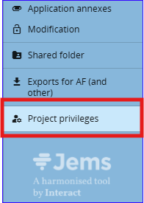
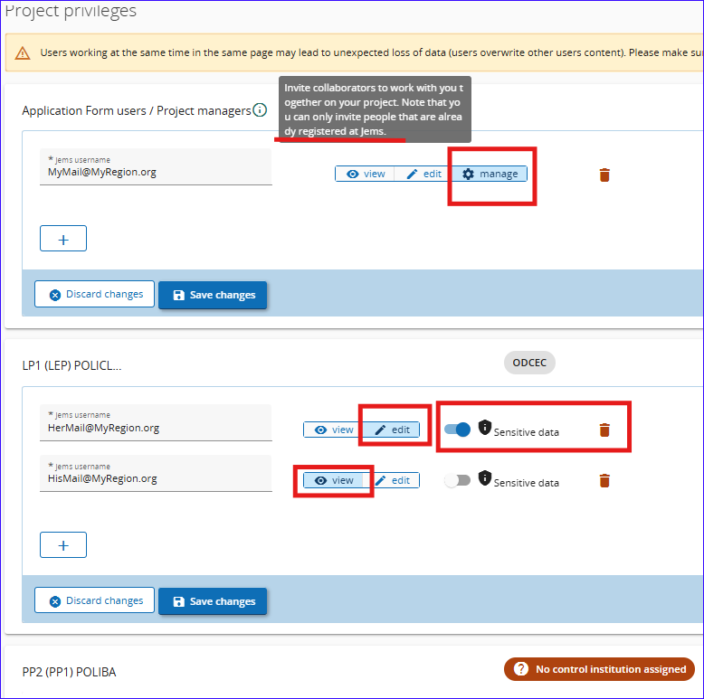
JEMS Reminders– Privileges
The Lead Partner of the project can give the privileges to the project partners and its management in JEMS.
The access can be given only to users already registered in JEMS.
The possible rights are:
Manage: can access all sections and use all functions, including the “privileges” (that’s why it should be limited to the minimum number of users!).
Edit: to be defined for one user at least for each partner
View: To see the sections without the possibility to insert or modify anything. (LP can put a “view” user on each partner to follow and support)
Sensitive data: You may prevent a user from seeing in Budget Lines their description, comments and related document.

Slide 4
JEMS –Application Modification – Points of attention
The modification can be opened by the JS/MA
Modifications are to be done by the Project managers with edit privileges (from the LP), apart from the information related to the partner information.
The different versions of the AF can be accessed from the left menu.
The unlocked sections are marked with light lock, if you need to edit other sections, you have to ask the JS to open them for you.
To change the regions of the address, you must start chronologically: Country, NUTS2 & then NUTS3
If the modified page can’t be saved, then check first the characters limit in that section.
The priority and programme specific objective of a contracted project cannot be changed.
Flat rate options cannot be changed.
Existing activities, deliverables, outputs or results cannot be removed but can be modified or deactivated.

Slide 5
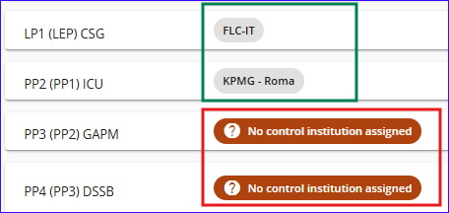
JEMS – Controller assignment procedure
Control Contact Point (CCP) of the country
JS/MA
Selection of Controller
Approval of Controller
Creation in Jems of Controller/Institution
Assignment in Jems of Controller/Institution
Role Attribution in Jems of Controller/Institution
The controller must register and confirm the registration, on https://jems.interregnextmed.eu/, at the latest before the last step.
In project priviliges, you can see which partner has an assigned controller already

Slide 6
JEMS – Reporting

Slide 7
JEMS – Reporting – Difference between LP role and PP role
Lead Partner | Partner
Must fill Project Report AND Partner Report | Fills only Partner Report
Must fill Work Plan Progress in Project Report | Filling Work Plan Progress is optional and used for internal use with LP

Slide 8
JEMS – Reporting – Points of attention
The Lead Partner must fill the own Partner report AND the Project Report
If Project Modification is opened, the report will be linked to the last approved Application. In case that the modification needs to be included in the report, wait for the approval before adding a report. (if you already added the report, then delete it!)
All partners can see the Project Report

Slide 9
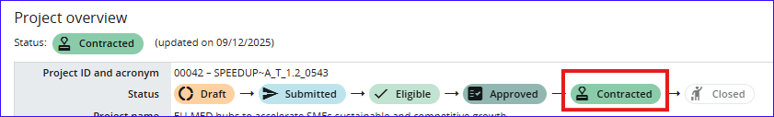
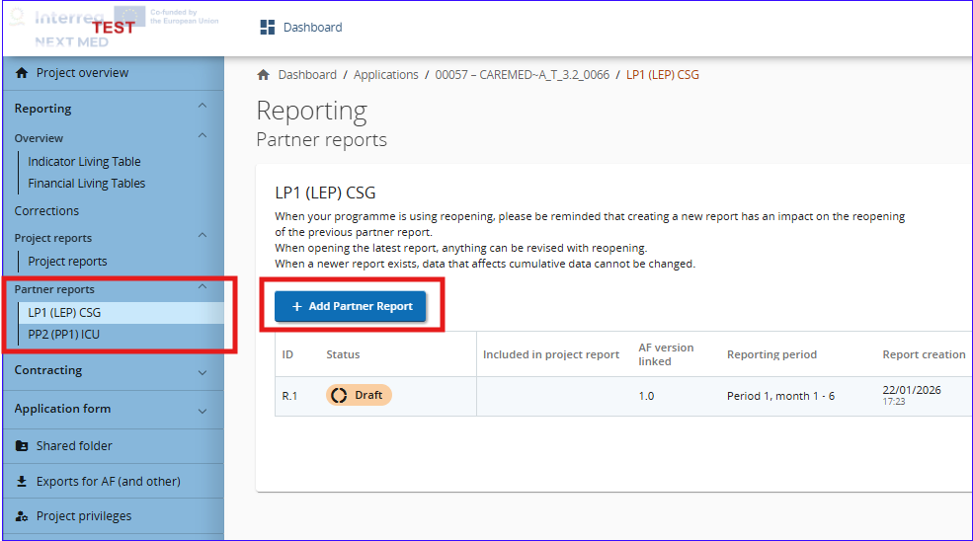
JEMS – Reporting – Creating a Partner report (LP too!)
When the project is in contracted status, the reporting section is opened for reports creation.
You can now Add Partner Report (LP and PP) and start filling

Slide 10
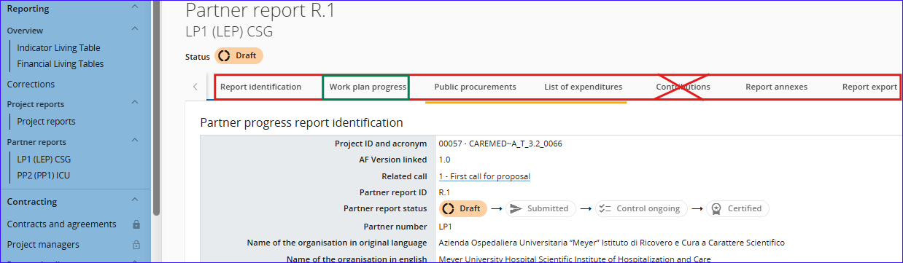
JEMS – Partner Reporting – Sections
Each Partner is responsible to fill its own report, mainly:
Report identification
Public Procurement
List of expenditures
All with the required annexes.
As for the Work plan progress, it will not be transferred to the Project Report automatically and is used only for the LP to collect data.
No need to fill contribution section in our programme

Slide 11
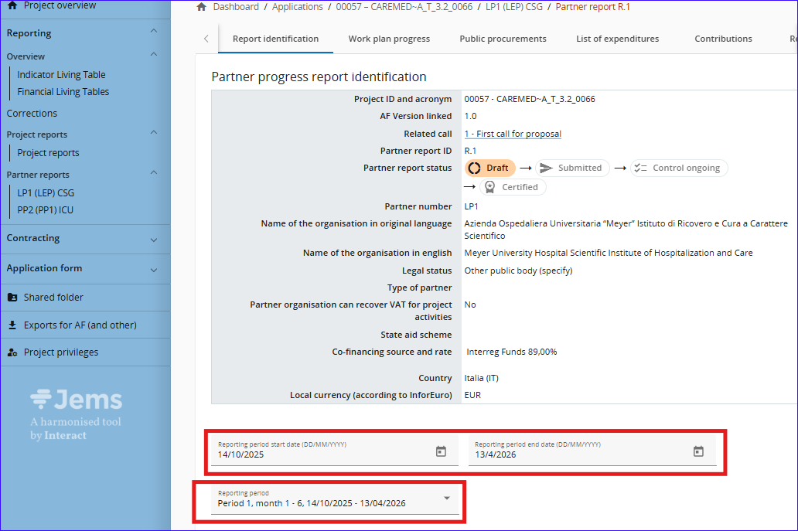
JEMS – Reporting – report Identification
The reporting period drop-down menu is pre-defined, according to the contract signatures; Select the suitable reporting period.
As for the Start and End dates of the reporting period, fill-in the same dates as per the reporting period, unless instructed otherwise by the JS/MA.
Here each partner must describe its contribution in the reporting period including eventual problems and deviations

Slide 12
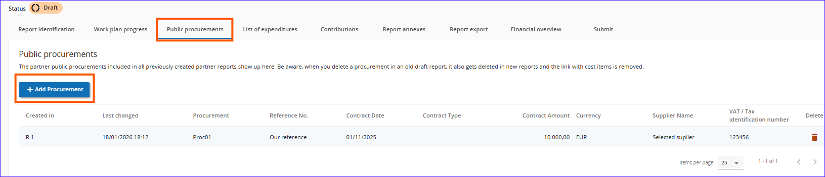
JEMS – Reporting – Procurement
In this section, information related to the procurement, following the guidelines, are to be filled.
Please refer to the PIM for further information

Slide 13
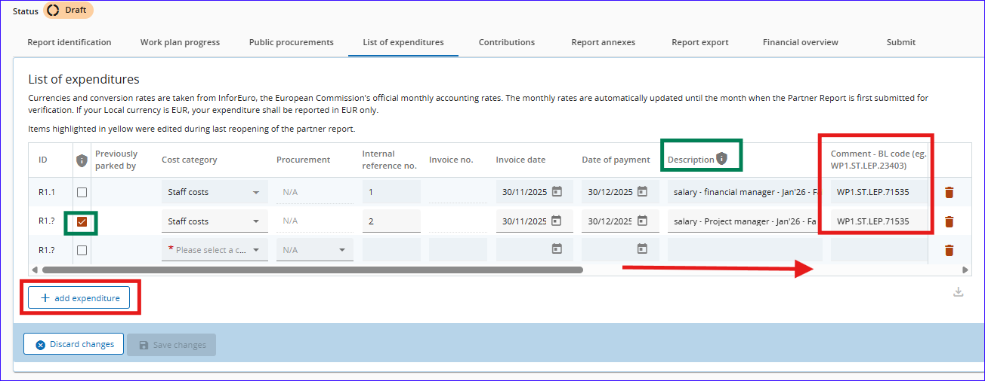
JEMS – Reporting – List of expenditures
The expenditures incurred and paid in the reporting period are to be filled in here,
You can “add expenditure”, as much needed, and fill all the related fields.
The ones highlighted with shield are the “sensitive data” to be hidden from unauthorised persons.
You can add attachment only after saving the changes.
You can’t save if you leave the required fields empty in a line

Slide 14
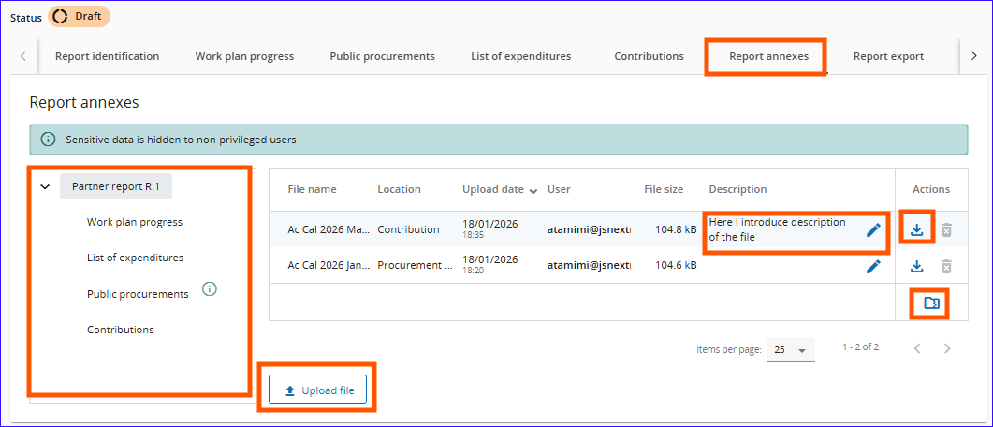
JEMS – Reporting –Annexes
This section shows all uploaded files in other sections with directory tree.
You can download a file, all files (in zipped folder) or upload new files.
Points of attention:
Do not upload documents you are not required, nor requested, to upload.
Compress files related to the same catgeory as one zipped file
Name files in comprehensive way
If you scan documents, make sure that they are readable and with reasonable size.
You may add description to the documents here (250 characters max.)

Slide 15
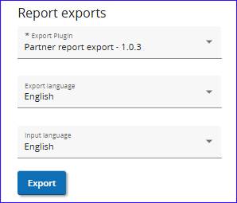
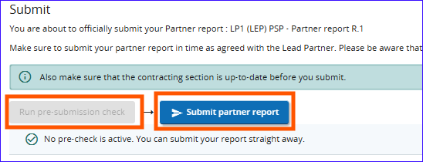
JEMS – Reporting – Export and submission
You can export the report in PDF format by selecting the right plugin.
The exported file is stamped with date and time,
You may export the file in English or French.
Prior to the submission, you have to click on “Run pre-submission check”,
Then “Submit”

Slide 16
JEMS – Project Reporting (by LP) Differences

Slide 17
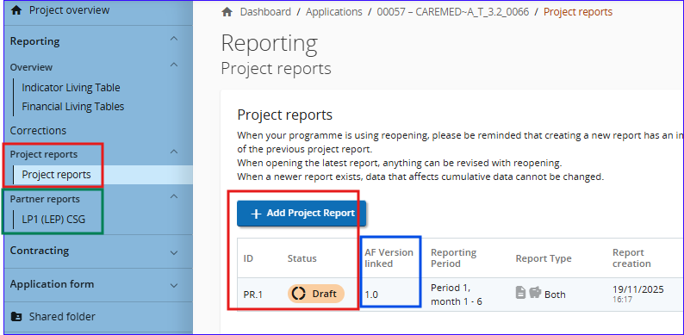
JEMS – Reporting – Creating a Project report by LP
When the project is in contracted status, the reporting section is opened for reports creation.
You can now Add Project Report (LP) and start filling.
Attention:
Project Report is different than LP1Partner Report, both must be filled by the LP
When you add a project report, the latest approved Application will be linked to it. So, if you have an opened Application modification, that you want the changes to be included in the report, then you have to wait for the approval before opening the report (if you’ve opened it, then delete it!)

Slide 18
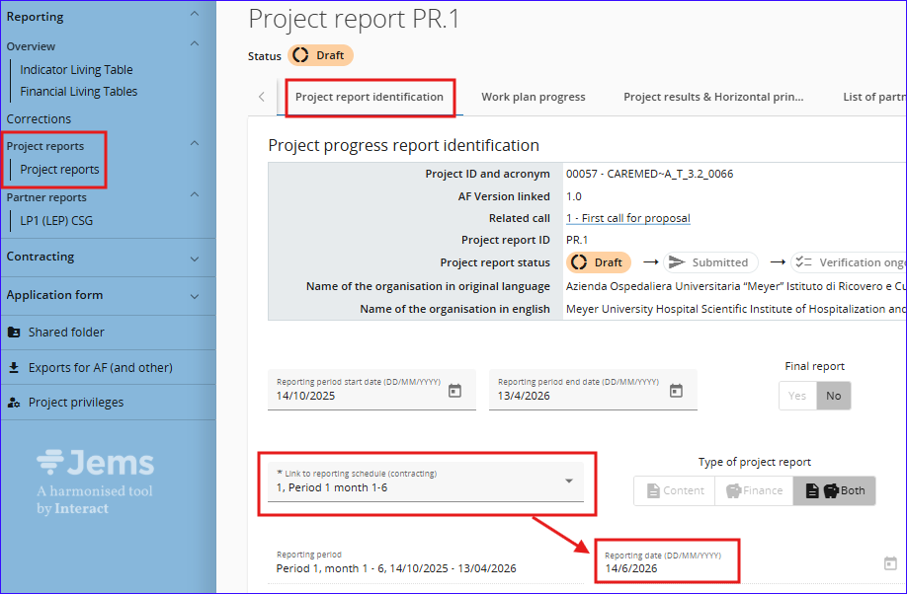
JEMS – Reporting – Project Report Identification
Similar to Partner Report, all information related to the filling of the dates are the same (reporting period drop-down menu, Final Report or not, Start and End dates, Type of the report…
Except for:
The link to reporting schedule is set by JS/MA (check with your corresponding JS Expert)
This is related to the deadline of the report submission.
If you were granted an extension of deadline, double check the date and contact your JS corresponding expert if needed.

Slide 19
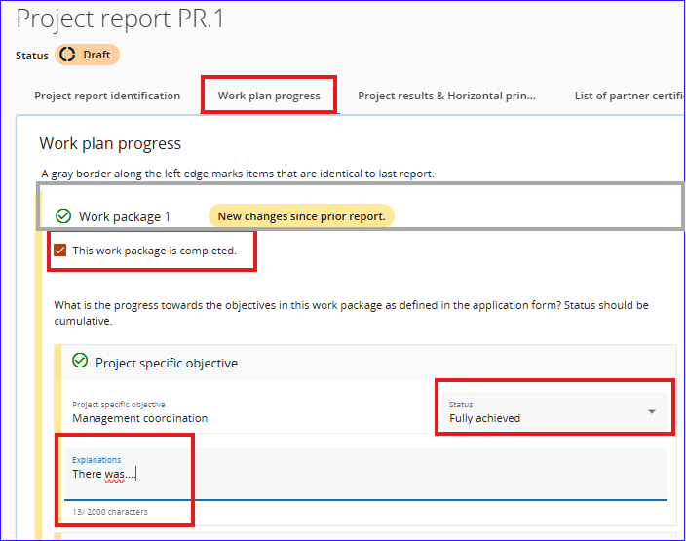
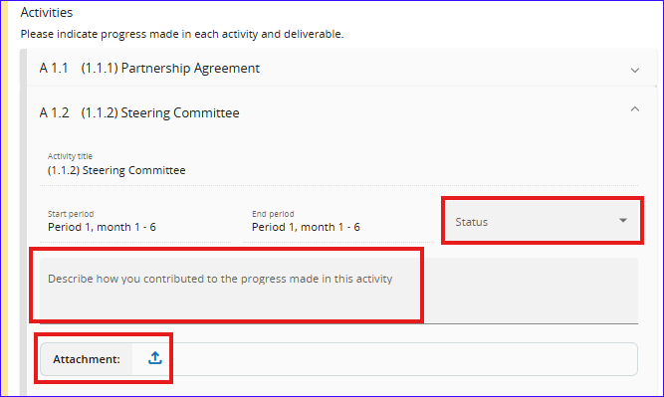
JEMS – Reporting – Work Plan Progress (LP)
Click on the area highlighted in grey to expand the section
Introduce the description of the progress, status of the work package and tick the box if you completed the WP.
Same for the related activity and Output.
The documents related to the activity is to be uploaded here (Output attachments are just under Output).

Slide 20
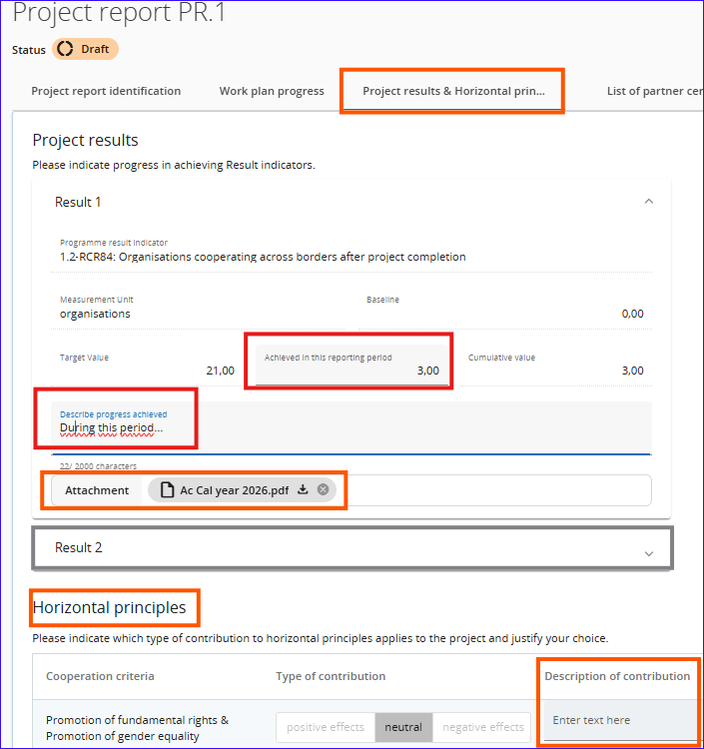
JEMS – Reporting – Project Results and horizontal Principles (LP)
Introduce the value of the achieved result for this reporting period and describe.
The description of the Horizontal Principles are to be filled in this section too.
The documents related to the filled result is to be uploaded here

Slide 21
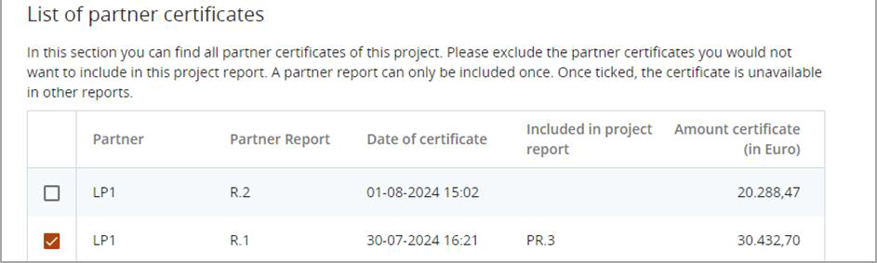
JEMS – Reporting – List of Partner Certificates
Upon creation of a new project report, all available partner report in state certified, which are not yet included in any other project report, are included in the newly created project report.
If a certified partner report shall be excluded in this project report, the respective partner certificate needs to be unticked
Point of attention: You can include here Certificates from an earlier or the current reporting period only (No certificate from the next reporting period to be included)

Slide 22
JEMS – Documents Where should I upload the required documents

Slide 23
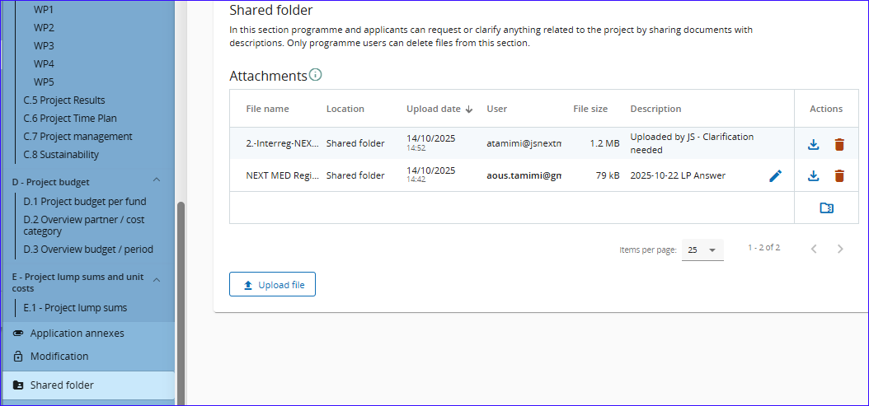
JEMS – Shared Folder
Shared Folder can be used to exchange documents with the JS and MA.
Keep file names clear and expressive, you can add short description to clarify further if needed.
As for annexes, you can download the files individually or a bulk in a compressed file.
The details are in Annex A of JEMS Guide

Slide 24
JEMS – Submission of Reports and their reopening

Slide 25
JEMS – Submission of Reports
Partner (Including LP)
Controller
Partner Report
Draft/Reopened
Submitted
Control ongoing/
Control Reopened
Certified
Project Report
Draft/Reopened
Submitted
Verified
Paid
Lead Partner
JS/MA
Paying Authority

Slide 26
JEMS – Reopening of Reports
Controller
Reopen Partner report
JS/MA
Reopen Control
Partner Report (PP/LP)
Draft/Reopened
Submitted
Control ongoing/
Control Reopened
Certified
Project Report (LP)
Draft/Reopened
Submitted
Verified
Paid
JS/MA
Reopen Project Report
JS/MA
Reopen Verification
Paying Authority
No Opening after payment!

Slide 27
Thank You Merci
شكراً

